Slide 1
Foundations of Control
Chapter
18

Slide 2
L E A R N I N G O U T L I N E
Follow this Learning Outline as you read and study this chapter.
What Is Control and Why Is It Important?
  Define control.
  Contrast the three approaches to designing control systems.
  Discuss the reasons why control is important.
  Explain the planning-controlling link.
The Control Process
  Describe the three steps in the control process.
  Explain why what is measured is more critical than how it’s measured.
  Explain the three courses of action managers can take in controlling.

Slide 3
L E A R N I N G O U T L I N E (cont’d)
Follow this Learning Outline as you read and study this chapter.
Controlling Organizational Performance
  Define organizational performance.
  Describe the most frequently used measures of organizational performance.
Tools for Organizational Performance
  Contrast feedforward, concurrent, and feedback controls.
  Explain the types of financial and information controls managers can use.
  Describe how balanced scorecards and benchmarking are used in controlling.

Slide 4
L E A R N I N G O U T L I N E (cont’d)
Follow this Learning Outline as you read and study this chapter.
Contemporary Issues in Control
  Describe how managers may have to adjust controls for cross-cultural differences.
  Discuss the types of workplace concerns managers face and how they can address those concerns.
  Explain why control is important to customer interactions.
  Discuss what corporate governance is and how it’s changing.

Slide 5
What Is Control?
Controlling
  The process of monitoring activities to ensure that they are being accomplished as planned and of correcting any significant deviations.
The Purpose of Control
  To ensure that activities are completed in ways that lead to accomplishment of organizational goals.

Slide 6
Designing Control Systems
Market Control
  Emphasizes the use of external market mechanisms to establish the standards used in the control system.
    External measures: price competition and relative market share
Bureaucratic Control
  Emphasizes organizational authority and relies on rules, regulations, procedures, and policies.
Clan Control
  Regulates behavior by shared values, norms, traditions, rituals, and beliefs of the firm’s culture.

Slide 7
Exhibit 18–1 Characteristics of Three Approaches to Control Systems
Type of Control | Characteristics
Market | Uses external market mechanisms, such as price competition and relative market share, to establish standards used in system. Typically used by organizations whose products or services are clearly specified and distinct and that face considerable marketplace competition.
Bureaucratic | Emphasizes organizational authority. Relies on administrative and hierarchical mechanisms, such as rules, regulations, procedures, policies, standardization of activities, well-defined job descriptions, and budgets to ensure that employees exhibit appropriate behaviors and meet performance standards.
Clan | Regulates employee behavior by the shared values, norms, traditions, rituals, beliefs, and other aspects of the organization’s culture. Often used by organizations in which teams are common and technology is changing rapidly.

Slide 8
Why Is Control Important?
As the final link in management functions:
  Planning
    Controls let managers know whether their goals and plans are on target and what future actions to take.
  Empowering employees
    Control systems provide managers with information and feedback on employee performance.
  Protecting the workplace
    Controls enhance physical security and help minimize workplace disruptions.

Slide 9
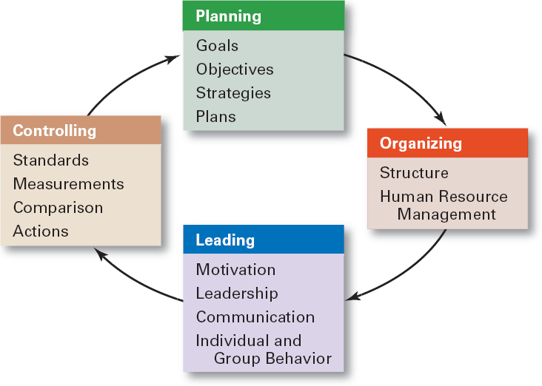
Exhibit 18–2 The Planning–Controlling Link

Slide 10
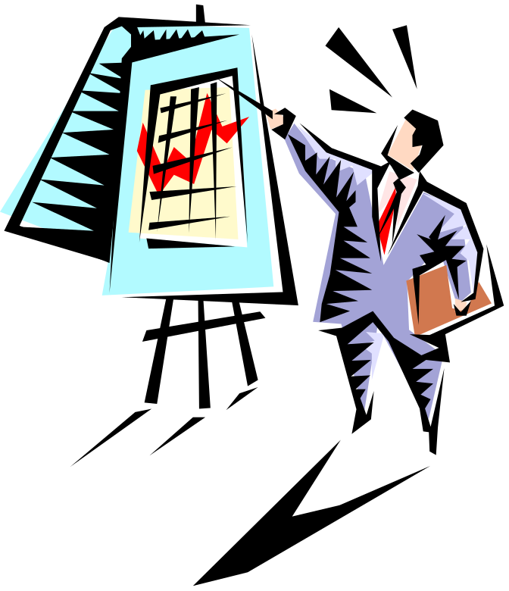
The Control Process
The Process of Control
  Measuring actual performance.
  Comparing actual performance against a standard.
  Taking action to correct deviations or inadequate standards.

Slide 11
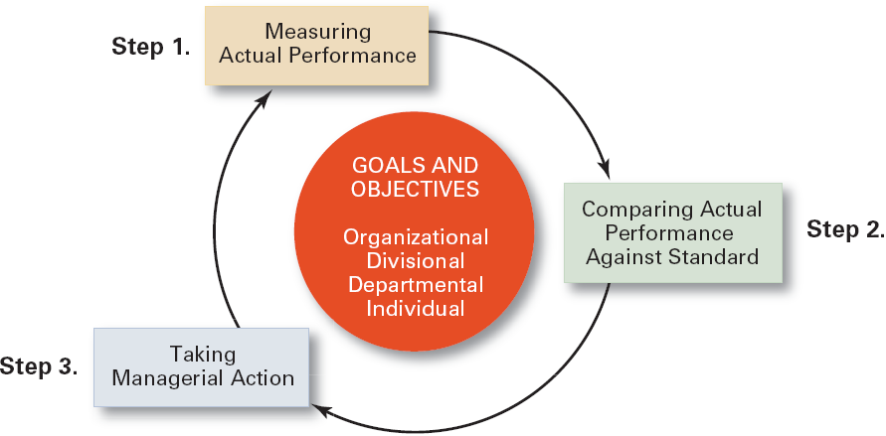
Exhibit 18–3 The Control Process

Slide 12
Measuring: How and What We Measure
Sources of Information (How)
  Personal observation
  Statistical reports
  Oral reports
  Written reports
Control Criteria (What)
  Employees
    Satisfaction
    Turnover
    Absenteeism
  Budgets
    Costs
    Output
    Sales

Slide 13
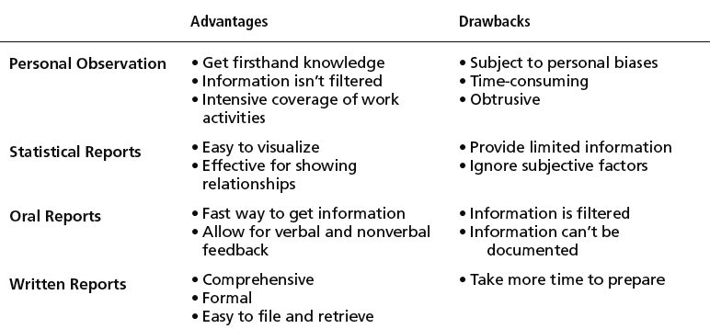
Exhibit 18–4 Common Sources of Information for Measuring Performance

Slide 14
Comparing
Determining the degree of variation between actual performance and the standard.
  Significance of variation is determined by:
    The acceptable range of variation from the standard (forecast or budget).
    The size (large or small) and direction (over or under) of the variation from the standard (forecast or budget).

Slide 15
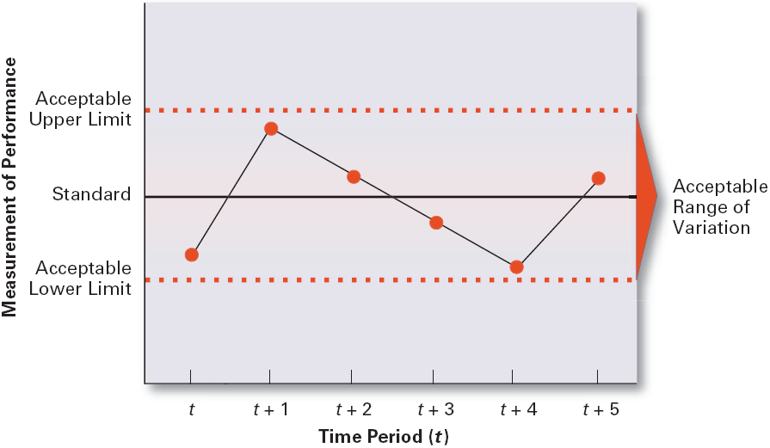
Exhibit 18–5 Defining the Acceptable Range of Variation

Slide 16
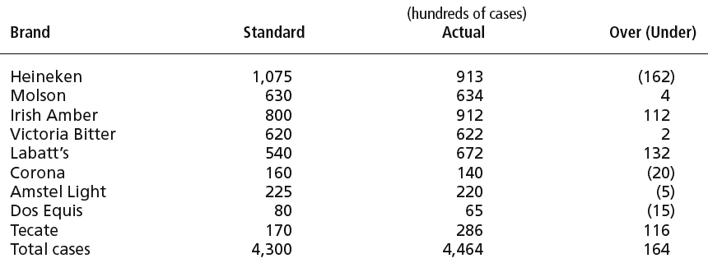
Exhibit 18–6 Sales Performance Figures for July, Eastern States Distributors

Slide 17
Taking Managerial Action
Courses of Action
  “Doing nothing”
    Only if deviation is judged to be insignificant.
  Correcting actual (current) performance
    Immediate corrective action to correct the problem at once.
    Basic corrective action to locate and to correct the source of the deviation.
    Corrective Actions
      Change strategy, structure, compensation scheme, or training programs; redesign jobs; or fire employees

Slide 18
Taking Managerial Action (cont’d)
Courses of Action (cont’d)
  Revising the standard
    Examining the standard to ascertain whether or not the standard is realistic, fair, and achievable.
      Upholding the validity of the standard.
      Resetting goals that were initially set too low or too high.

Slide 19
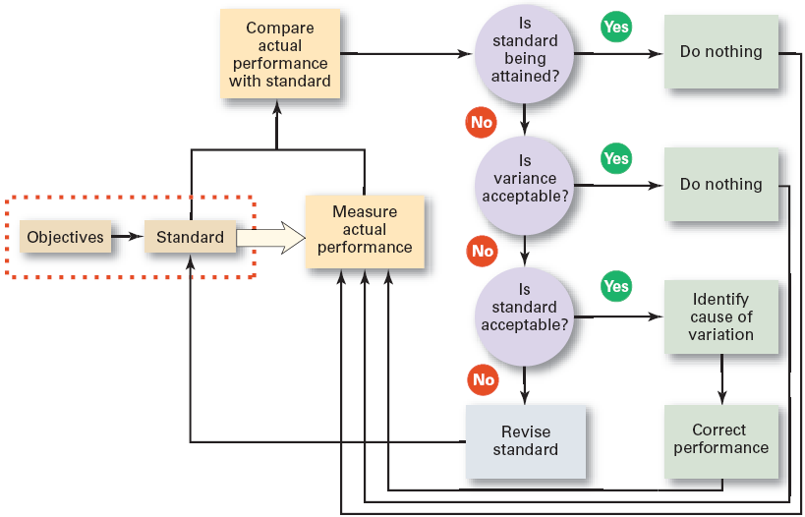
Exhibit 18–7 Managerial Decisions in the Control Process

Slide 20

Controlling for Organizational Performance
What Is Performance?
  The end result of an activity
What Is Organizational
Performance?
  The accumulated end results of all of the organization’s work processes and activities
    Designing strategies, work processes, and work activities.
    Coordinating the work of employees.

Slide 21
Organizational Performance Measures
Organizational Productivity
  Productivity: the overall output of goods and/or services divided by the inputs needed to generate that output.
    Output: sales revenues
    Inputs: costs of resources (materials, labor expense, and facilities)
  Ultimately, productivity is a measure of how efficiently employees do their work.

Slide 22
Organizational Performance Measures
Organizational Effectiveness
  Measuring how appropriate organizational goals are and how well the organization is achieving its goals.
    Systems resource model
      The ability of the organization to exploit its environment in acquiring scarce and valued resources.
    The process model
      The efficiency of an organization’s transformation process in converting inputs to outputs.
    The multiple constituencies model
      The effectiveness of the organization in meeting each constituencies’ needs.

Slide 23
Industry and Company Rankings
Industry rankings on:
  Profits
  Return on revenue
  Return on shareholders’ equity
  Growth in profits
  Revenues per employee
  Revenues per dollar of assets
  Revenues per dollar of equity
Corporate Culture Audits
Compensation and benefits surveys
Customer satisfaction
surveys

Slide 24
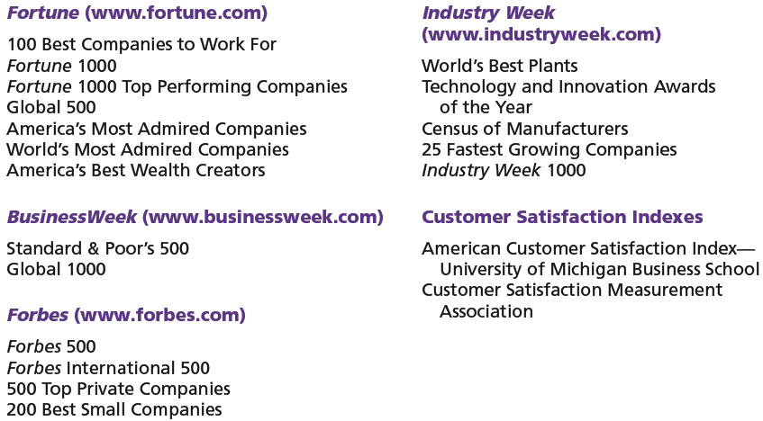
Exhibit 18–8 Popular Industry and Company Rankings

Slide 25
Tools for Controlling Organizational Performance
Feedforward Control
  A control that prevents anticipated problems before actual occurrences of the problem.
    Building in quality through design.
    Requiring suppliers conform to ISO 9002.
Concurrent Control
  A control that takes place while the monitored activity is in progress.
    Direct supervision: management by walking around.

Slide 26
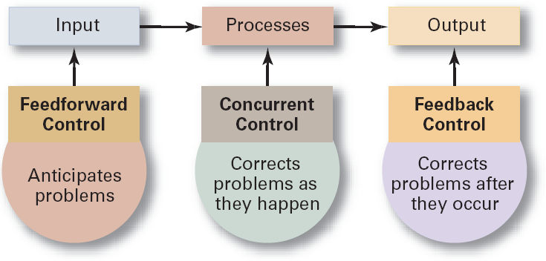
Exhibit 18–9 Types of Control

Slide 27
Tools for Controlling Organizational Performance (cont’d)
Feedback Control
  A control that takes place after an activity is done.
    Corrective action is after-the-fact, when the problem has already occurred.
  Advantages of feedback controls:
    Provide managers with information on the effectiveness of their planning efforts.
    Enhance employee motivation by providing them with information on how well they are doing.

Slide 28
Tools for Controlling Organizational Performance: Financial Controls
Traditional Controls
  Ratio analysis
    Liquidity
    Leverage
    Activity
    Profitability
  Budget Analysis
    Quantitative standards
    Deviations
Other Measures
  Economic Value Added (EVA)
  Market Value Added (MVA)

Slide 29
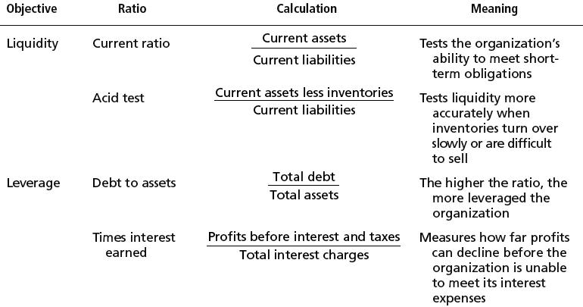
Exhibit 18–10 Popular Financial Ratios

Slide 30
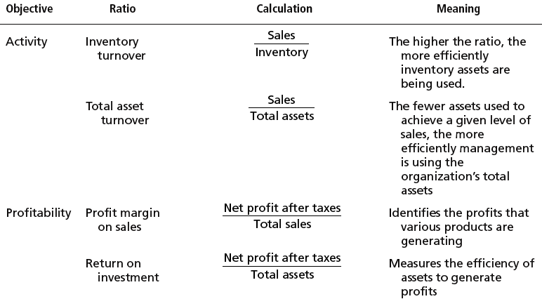
Exhibit 18–10 Popular Financial Ratios (cont’d)

Slide 31
Tools for Controlling Organizational Performance: Financial Controls (cont’d)
Other Measures
  Economic Value Added (EVA)
    How much value is created by what a company does with its assets, less any capital investments in those assets: the rate of return earned over and above the cost of capital.
      The choice is to use less capital or invest in high-return projects.

Slide 32
Tools for Controlling Organizational Performance: Financial Controls (cont’d)
Other Measures (cont’d)
  Market Value Added (MVA)
    The value that the stock market places on a firm’s past and expected capital investment projects
    If the firm’s market value (its stock and debt) exceeds the value of its invest capital (its equity and retained earnings), then managers have created wealth.
The Practice of Managing Earnings

Slide 33
Controlling Organizational Performance
Balanced Scorecard
  Is a measurement tool that uses goals set by managers in four areas to measure a company’s performance:
    Financial
    Customer
    Internal processes
    People/innovation/growth assets
  Is intended to emphasize that all of these areas are important to an organization’s success and that there should be a balance among them.

Slide 34
Information Controls
Purposes of Information Controls
  As a tool to help managers control other organizational activities.
    Managers need the right information at the right time and in the right amount.
  As an organizational area that managers need to control.
    Managers must have comprehensive and secure controls in place to protect the organization’s important information.

Slide 35
Information Controls
Management Information Systems (MIS)
  A system used to provide management with needed information on a regular basis.
    Data: an unorganized collection of raw, unanalyzed facts (e.g., unsorted list of customer names).
    Information: data that has been analyzed and organized such that it has value and relevance to managers.

Slide 36
Benchmarking of Best Practices
Benchmark
  The standard of excellence against which to measure and compare.
Benchmarking
  Is the search for the best practices among competitors or noncompetitors that lead to their superior performance.
  Is a control tool for identifying and measuring specific performance gaps and areas for improvement.

Slide 37
Exhibit 18–11 Steps to Successfully Implement an Internal Benchmarking Best Practices Program
Connect best practices to strategies and goals.
Identify best practices throughout the organization.
Develop best practices reward and recognition systems.
Communicate best practices throughout the organization.
Create a best practices knowledge-sharing system.
Nurture best practices on an ongoing basis.

Slide 38
Contemporary Issues in Control
Cross-Cultural Issues
  The use of technology to increase direct corporate control of local operations
  Legal constraints on corrective actions in foreign countries
  Difficulty with the comparability of data collected from operations in different countries

Slide 39
Contemporary Issues in Control (cont’d)
Workplace Concerns
  Workplace privacy versus workplace monitoring:
    E-mail, telephone, computer, and Internet usage
    Productivity, harassment, security, confidentiality, intellectual property protection
  Employee theft
    The unauthorized taking of company property by employees for their personal use.
  Workplace violence
    Anger, rage, and violence in the workplace is affecting employee productivity.

Slide 40
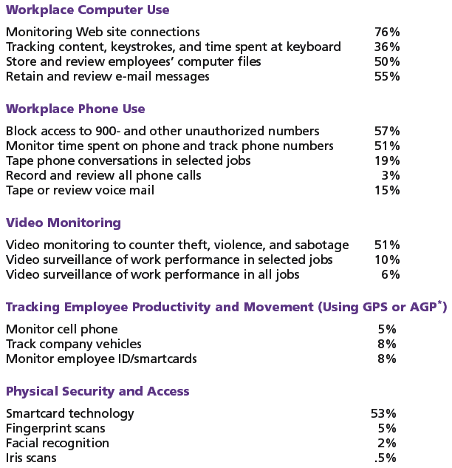
Exhibit 18–12
Types of Workplace Monitoring by Employers
Source: American Management Association/ePolicy Institute Research, “2005 Electronic Monitoring & Surveillance Survey,” American Management Association.

Slide 41
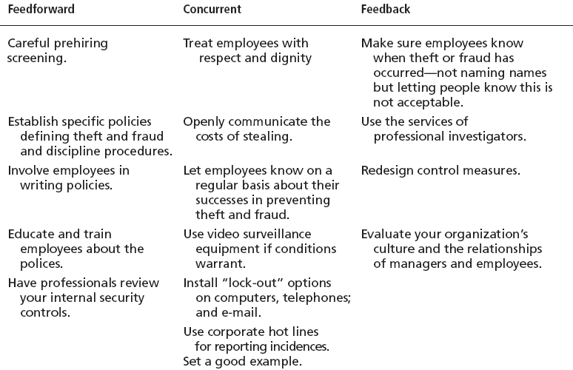
Exhibit 18–13 Control Measures for Employee Theft or Fraud
Sources: Based on A.H. Bell and D.M. Smith. “Protecting the Company Against Theft and Fraud,” Workforce Online (www.workforce.com) December 3, 2000; J.D. Hansen. “To Catch a Thief,” Journal of Accountancy, March 2000, pp. 43–46; and J. Greenberg, “The Cognitive Geometry of Employee Theft,” in Dysfunctional Behavior in Organizations: Nonviolent and Deviant Behavior, eds. S.B. Bacharach, A. O’Leary-Kelly, J.M. Collins, and R.W. Griffin (Stamford, CT: JAI Press, 1998), pp. 147–93.

Slide 42
Exhibit 18–14 Workplace Violence
Witnessed yelling or other verbal abuse 42%
Yelled at co-workers themselves 29%
Cried over work-related issues 23%
Seen someone purposely damage
machines or furniture 14%
Seen physical violence in the workplace 10%
Struck a co-worker 2%
Source: Integra Realty Resources, October-November Survey of Adults 18 and Over, in “Desk Rage.” BusinessWeek, November 20, 2000, p. 12.

Slide 43
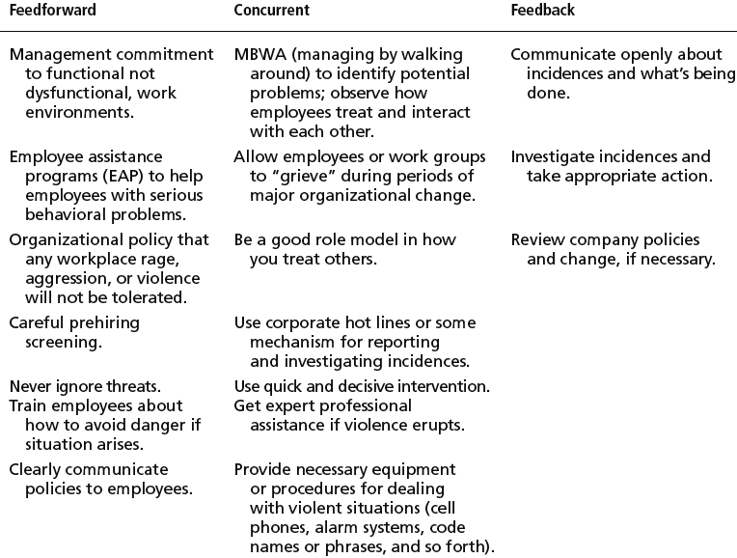
Exhibit 18–15 Control Measures for Deterring or Reducing Workplace Violence
Sources: Based on M. Gorkin, “Five Strategies and Structures for Reducing Workplace Violence,” Workforce Online (www.workforce.com). December 3, 2000; “Investigating Workplace Violence: Where Do You Start?” Workforce Online (www.forceforce.com), December 3, 2000; “Ten Tips on Recognizing and Minimizing Violence,” Workforce Online (www.workforce.com), December 3, 2000; and “Points to Cover in a Workplace Violence Policy,” Workforce Online (www.workforce.com), December 3, 2000.

Slide 44
Contemporary Issues in Control (cont’d)
Customer Interactions
  Service profit chain
    Is the service sequence from employees to customers to profit.
  Service capability affects service value which impacts on customer satisfaction that, in turn, leads to customer loyalty in the form of repeat business (profit).

Slide 45
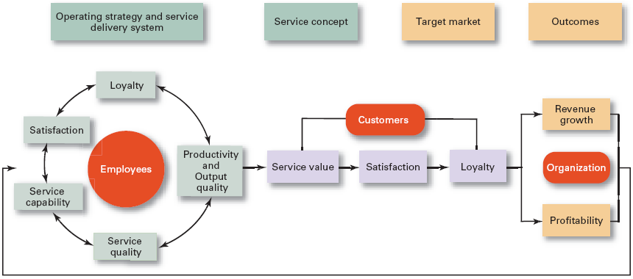
Exhibit 18–16 The Service Profit Chain
Source: Adapted and reprinted by permission of Harvard Business Review. An exhibit from “Putting the Service Profit Chain to Work,” by J. L. Heskett, T. O. Jones, G. W. Loveman, W. E. Sasser, Jr., and L. A. Schlesinger. March–April 1994: 166. Copyright (c) by the President and Fellows of Harvard College. All rights reserved. See also J. L. Heskett, W. E. Sasser, and L. A. Schlesinger, The Service Profit Chain (New York: Free Press, 1997).

Slide 46
Contemporary Issues in Control (cont’d)
Corporate Governance
  The system used to govern a corporation so that the interests of the corporate owners are protected.
    Changes in the role of boards of directors
    Increased scrutiny of financial reporting (Sarbanes-Oxley Act of 2002)
      More disclosure and transparency of corporate financial information
      Certification of financial results by senior management

Slide 47
Terms to Know
controlling
market control
bureaucratic control
clan control
control process
range of variation
immediate corrective action
basic corrective action
performance
organizational performance
productivity
organizational effectiveness
feedforward control
concurrent control
management by walking around
feedback control
economic value added (EVA)
market value added (MVA)

Slide 48
Terms to Know (cont’d)
management information system (MIS)
data
information
balanced scorecard
benchmarking
employee theft
service profit chain
corporate governance

